Slide 1
Sprint 1 Presentation & Retrospective

Slide 2
Agenda
Old Business: Team Member Roles & Responsibilities, Project Description, Team Working Agreement, Personas, MVP, Technology Stack.
New Business: Diagrams, Sprint 1 Kanban Status, Metrics.
Demo of Current Product
Retrospective (IdeaBoardz)
Sprint 2 Planning & Goals

Slide 3
Team
Charles Varga - DevOps/Tech Architect
Tara Edney - Frontend
Andeen Daley (Data Engineer/Database)
Younes Roumila (Backend)
Bella Gerken (AI/NLP Integration)
QA/QC 1 - Charles Varga
QA/QC 2 - James Simpson

Slide 4
Improvements from Feedback
-Using IdeaBoardz for retrospective

Slide 5
Project Description
The Intelligent Academic Path Optimizer is a proposed application which will streamline the academic advising workflow. The app is designed to use AI to facilitate decision making when generating a conflict-free academic schedule for students. By utilizing the Constraint Satisfaction Problem algorithms and predictive modeling, the application will dynamically output the most efficient path to graduation based on specific student parameters.

Slide 6
Team Working Agreement
Decision Making – Consensus, voting when necessary. Most decisions thus far have been reached by consensus, and the only vote that was taken was for the Project Logo, which was unanimous anyway.
-Team meetings – Decided using When2Meet on a weekly basis. Team has varying schedules week on week, so this is the best as opposed to a set meeting time.
-Team keeps teem accountable. We will use group accountability and help remind each other of deadlines.
-Thus far, we have been planning for a few extra days at the end of each sprint just in case things were missed. In Sprint 0, a few items were missed, but we had a few days clear things up.

Slide 7
Sprint 1 Goals
Building the core backend for the Python Optimization Engine.
Drafting the basic visual UI.
Setting up the initial AI resume parsing pipeline using Gemini.
“Working Software”
QA/Testing for User Stories that require them.

Slide 8
Personas
Academic Advisor: Isabelle Johnson, 42 · Pace University
Problem
Manually verifies prereqs and builds schedules for 100+ students
Changing requirements risk graduation delays
Goals
Accurate prereq and degree checks
Automated scheduling
Earlier risk flags
More time to help students
How IAPO Helps
Generates valid pathways so she can focus on mentorship
Graduate Student: William Court, 24 · CS Major
Problem
Confused about prereqs and availability each semester
Unclear requirements delay graduation and raise costs
Goals
Fastest path to graduate
"What-if" planning before registering
Balanced schedule
Steady GPA
How IAPO Helps
Builds an optimized schedule from his credits, goal date, and load
Dept. Administrator: Michael Rodriguez, 52 · CS Chair
Problem
Little visibility into which prereqs cause delays
Relies on manual progress reviews
Goals
Spot bottlenecks
Track student progression
Support data-driven decisions
Raise grad rates
How IAPO Helps
Surfaces bottlenecks from degree plans to guide curriculum planning

Slide 9
Minimum Viable Product (core features)
A user-friendly interface in which the user can interact with the AI tied to the app to receive feedback based on the input
A text input in which students can specify their particular academic needs to the AI
A clearly visible feedback mechanism which users can utilize to inform developers about the AI, particularly in cases when it generates incorrect information or hallucinates
A means for users to select the major that they are pursuing and at which level, be it undergraduate or graduate
Output from the AI which consists of the classes that the students should take based on specified major as well as any text input for specific academic needs in the prompt, and in which semesters these students should take specific classes

Slide 10
Tech Stack
Frontend
(React Website)
Figma
React JS
Native CSS
Email JS
Backend
(Web Server)
Python 3.12 w. FastAPI
Gemini API (AI Chat)
AWS DynamoDB + S3 (Accounts)
Web Hosting
Github Pages (Frontend)
PythonAnywhere (Web Server)
AWS (User Storage)
Gemini (AI Server)

Slide 11
Algorithms

Slide 12
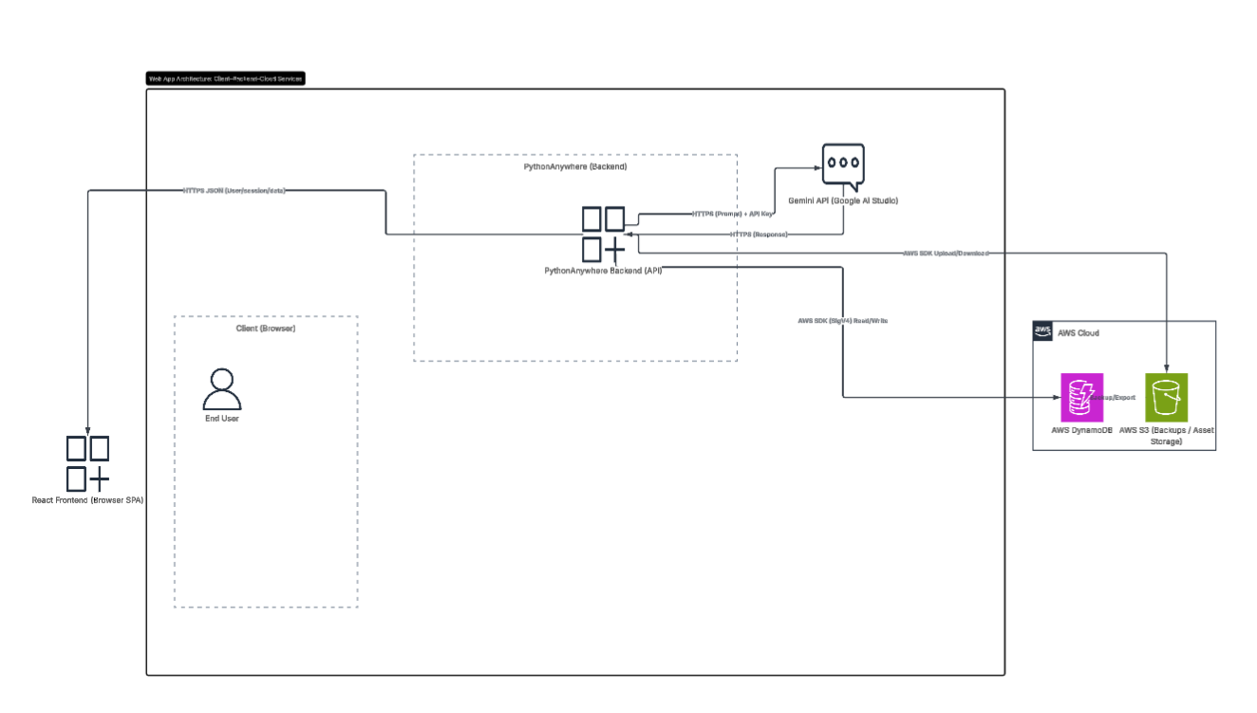
Systems Architecture

Slide 13
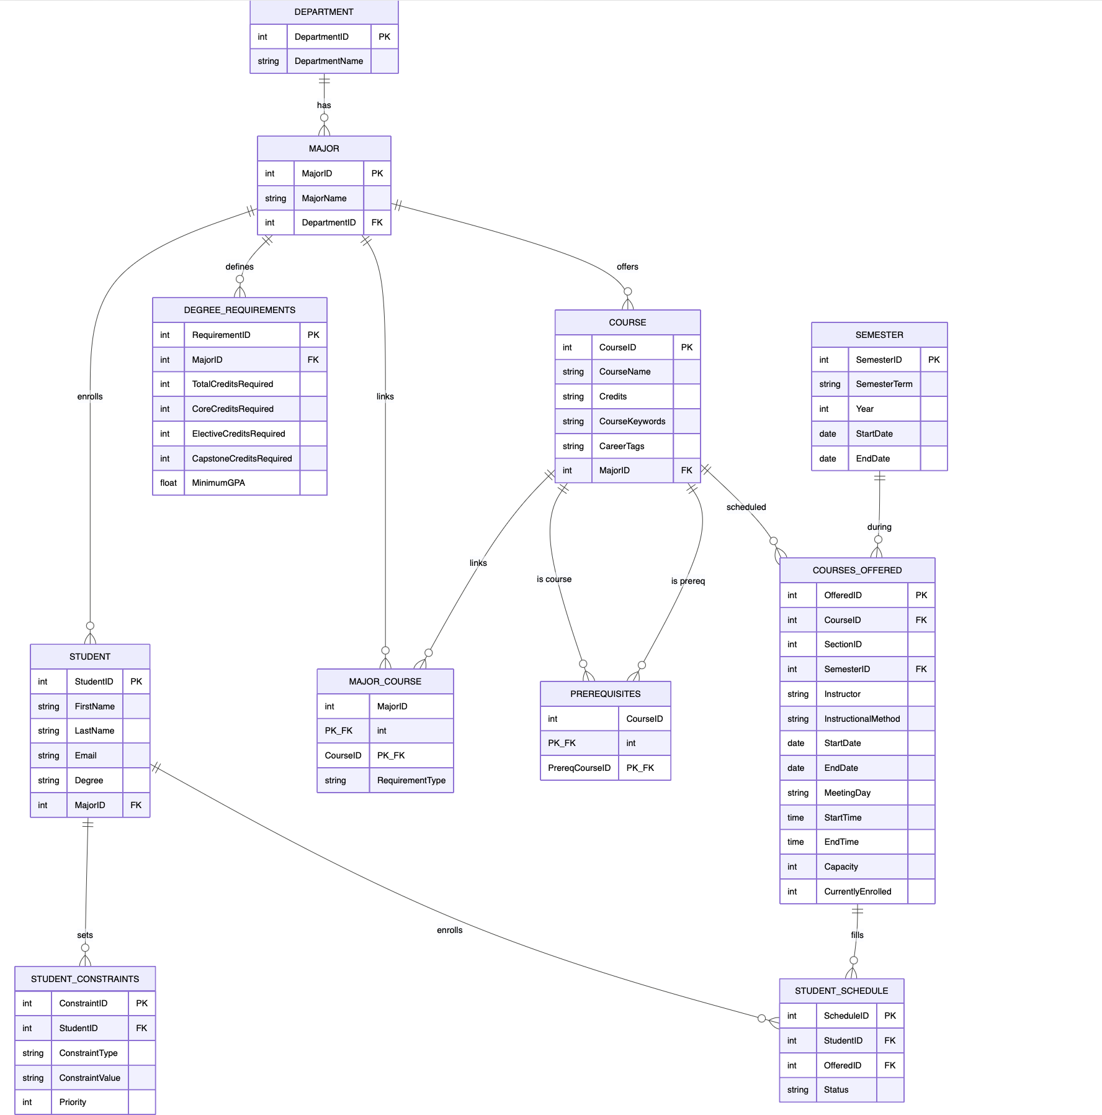
Database Design

Slide 14
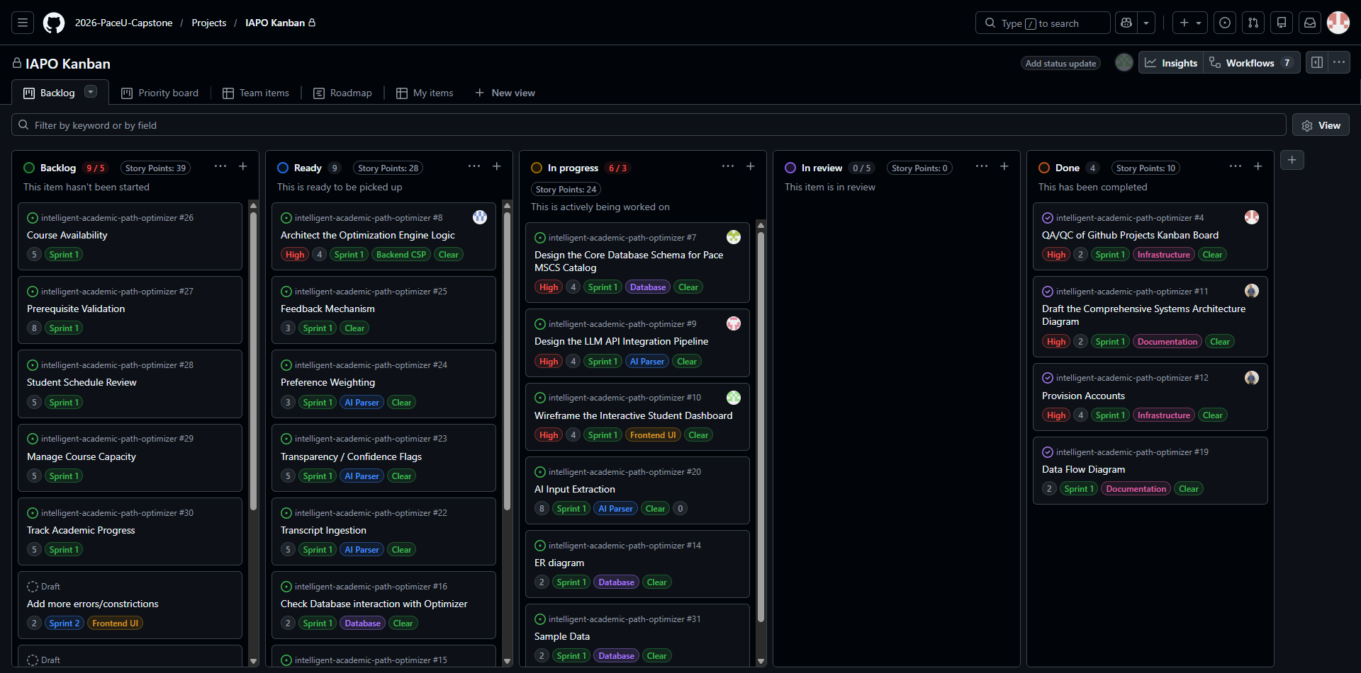
Product & Sprint 1 Backlog
https://github.com/orgs/2026-PaceU-Capstone/projects/2/views/1

Slide 15
Metrics

Slide 16
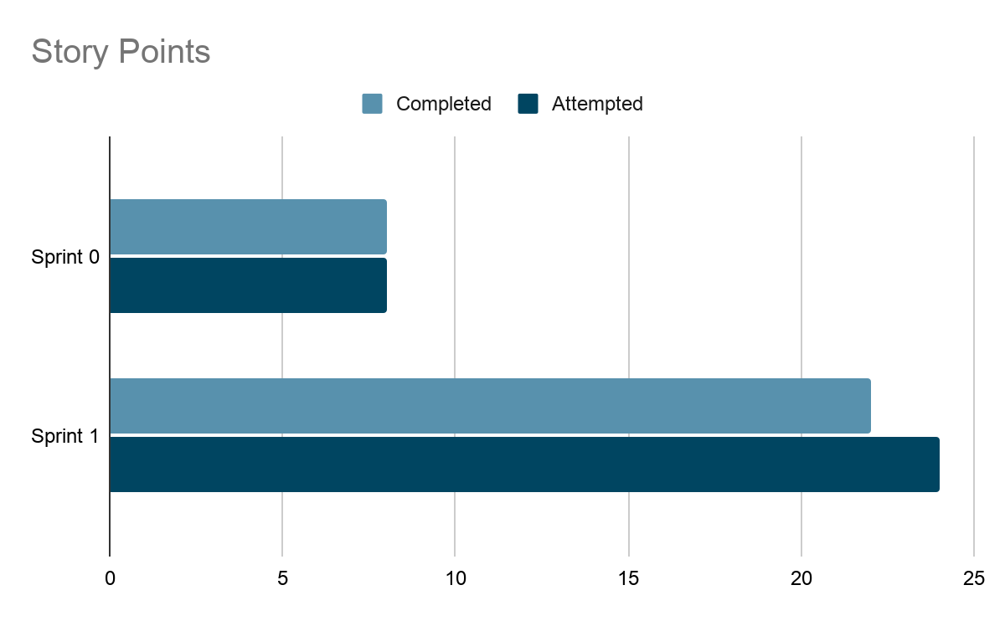
Team Velocity

Slide 17
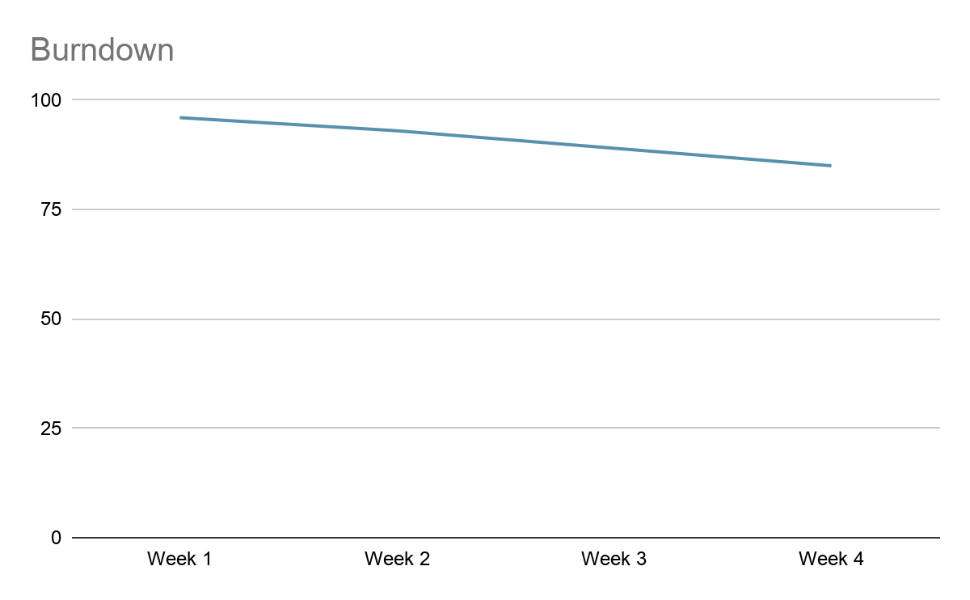
Burndown

Slide 18
Completed/Committed Ratio
22/24, 91%

Slide 19
Stories Committed to Sprint 2 (All)
https://github.com/orgs/2026-PaceU-Capstone/projects/2/views/1

Slide 20
Project Demo
-Frontend Demo
-Backend Demo
-AI Demo

Slide 21
Frontend Demo

Slide 22
Backend Demo

Slide 23
AI Demo

Slide 24
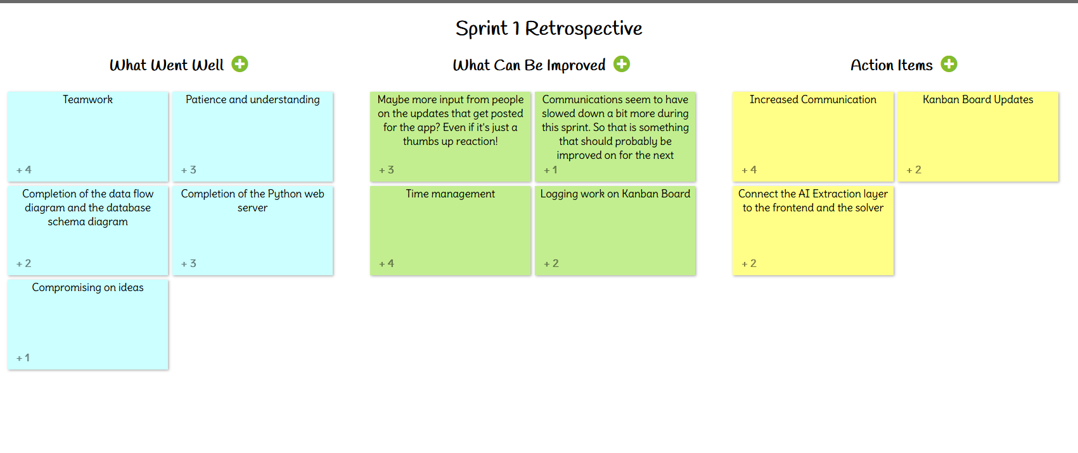
Retrospective
https://ideaboardz.com/for/Sprint%201%20Retrospective/5796994

Slide 25
Links:
Github: https://github.com/htmw/CS691-Summer2026-Team1/wiki#sprint-0
Kanban Board: https://github.com/orgs/2026-PaceU-Capstone/projects/2/views/1

